Slide 1

KERNEL-BASED VIRTUAL MACHINE ( KVM )

Slide 2
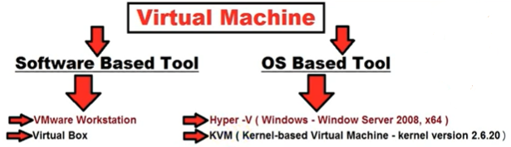
Introduction

Slide 3
Introduction
KVM (Kernel-based Virtual Machine) is the leading open source virtualization technology for Linux.
It is developed by Red Hat Corporation to provide a virtualization solution and services on the Linux operating system platform. It is designed over the primary Linux OS kernel.
It installs natively on all Linux distributions and turns underlying physical servers into hypervisors so that they can host multiple, isolated virtual machines (VMs).

Slide 4
KVM Architecture
KVM is an open-source full-virtualization solution for Linux on x86 hardware that supports virtualization extension.
It consists of two components:
QEMU
Loadable KVM kernel device driver module

Slide 5
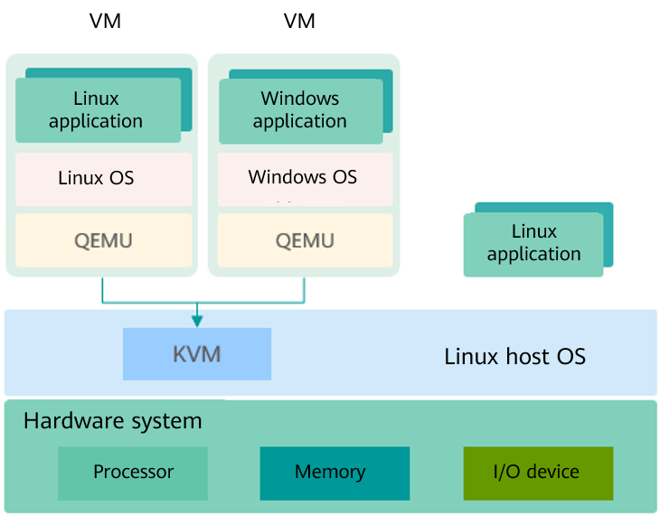
KVM Architecture

Slide 6
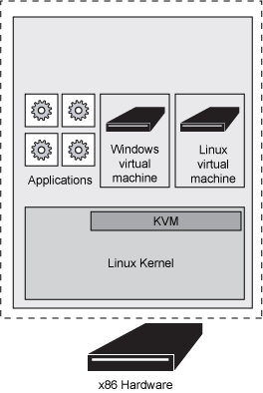
KVM Architecture

Slide 7
KVM Architecture
KVM is a kernel module of Linux. It makes Linux a hypervisor.
KVM does not simulate any hardware device. It is used to enable virtualization capabilities provided by the hardware, such as Intel VT-x, AMD-V, Arm virtualization extensions.
The user-mode QEMU simulates the mainboard, memory, and I/O devices. The user-mode QEMU works with the kernel KVM module to simulate VM hardware.
The guest OS runs on the hardware simulated by the QEMU and KVM.

Slide 8
KVM Architecture- Virtualization Components
KVM kernal: provides the core virtualization infrastructure to make the Linux system a hypervisor. Multiple VMs can run on the same host at the same time.
QEMU: simulates a processor and provides a set of device models to work with KVM to implement hardware-based virtualization simulation acceleration.

Slide 9
Link for details:
https://developer.ibm.com/articles/cl-hypervisorcompare-kvm/

